Slide 1
Java API and Class Libraries
Object Oriented Programming
AAPP013-4-2
Copyright 2016 Asia Pacific Institute of Information Technology

Slide 2
Topic & Structure of the lesson
Java API
Random Class
Date class
Calender class
Gregorian Calender classes
String class
StringBuffer Class

Slide 3
Learning Outcomes
At the end of this topic, you should be able to:
Implement the usage of various classes
Use the drawing methods available
Notes:
<number>

Slide 4
Key Terms you must be able to use
If you have mastered this topic, you should be able to use the following terms correctly in your assignments and exams:
Java API
Notes:
<number>

Slide 5
A Tour of the Java API
An API User’s Guide, in HTML, is bundled with Java
Much of the “learning curve” is in the API
Let’s look at some packages

Slide 6
The Java API
java.applet
Applet class
java.awt
Windows, buttons, mouse, etc.
java.awt.image
image processing
java.awt.peer
GUI toolkit
java.io
System.out.print
java.lang
length method for arrays
exceptions
java.net
sockets
java.util
System.getProperty
See https://docs.oracle.com/en/java/javase/18/docs/api/index.html for the current APIs

Slide 7
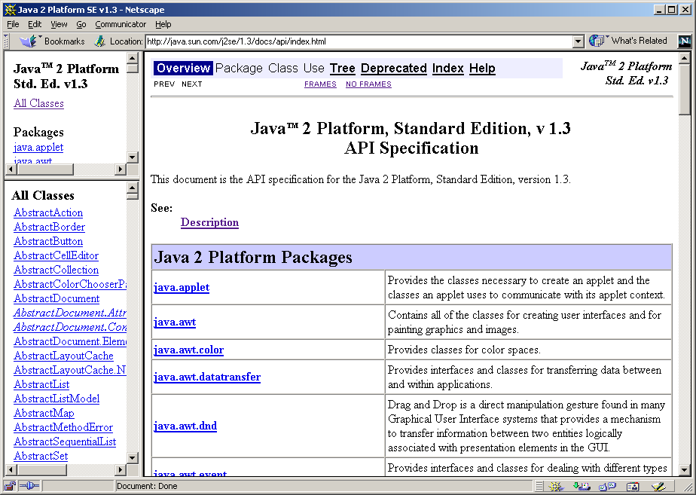
Sample API

Slide 8
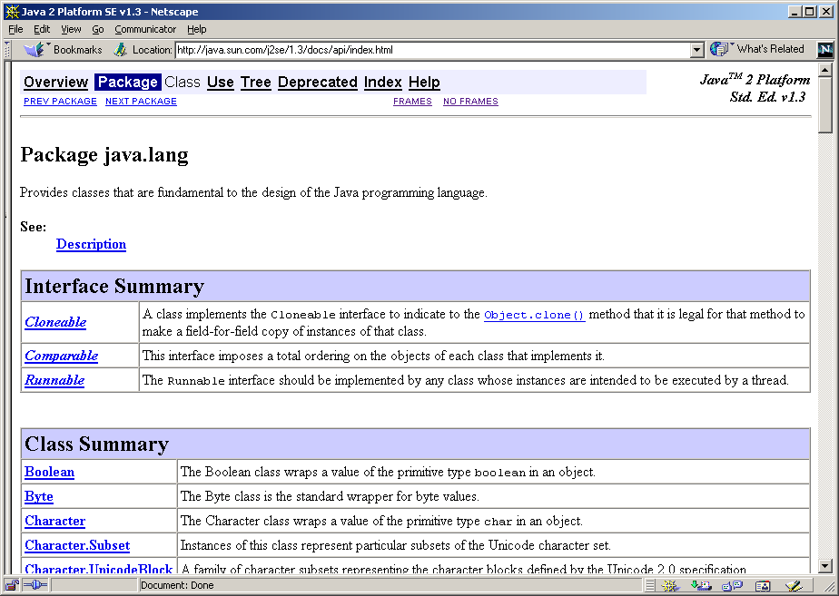
Sample API

Slide 9
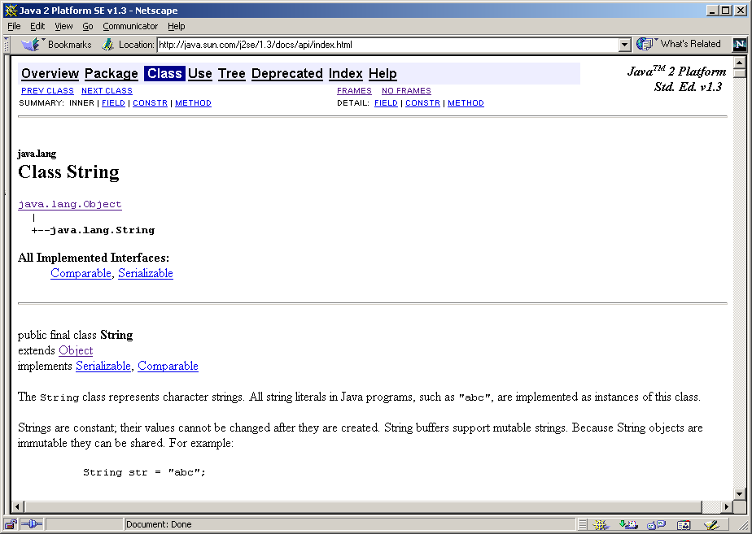
Sample API

Slide 10
Random Class
Random numbers are extremely useful, for eg.,in generating moves in a game or as test data for computer programs.
Algorithms that generate random numbers,admittedly, provide “pseudorandom” numbers.
Java’s Random class in the java.util package includes a variety of methods to generate pseudo-random numbers.

Slide 11
Methods of the Random Class
Constructor:
Random() → creates a new random number generator; returns a reference to the new object.
Instance Methods:
nextBoolean() → returns a boolean;the next pseudo-random,uniformly distributed boolean value from this random number generator’s sequence.

Slide 12
Methods of the Random Class
nextDouble() → returns a double: the next pseudo-random,uniformly distributed double value between 0.0 to 1.0 from this random number generator’s sequence.
nextInt() → returns an int: the next pseudo-random,uniformly distributed int value from this random number generator’s sequence.
nextInt(int n) → returns an int: a pseudo-random,uniformly distributed int value between 0 and the specified value, drawn from this random number generator’s sequence.

Slide 13
Example 1: Random Bits
The RandomBits program generates a series of random bits (0 or 1).
Each bit is represented as a character and placed in a 10-character string buffer at a random location in the string.
After each bit is inserted, the string buffer is printed.

Slide 14
Program :Random Bits
import java.util.*;
public class RandomBits {
public static void main(String args[]) {
long t1 = System.currentTimeMillis();
int temp = 0;
StringBuffer sb = new StringBuffer(" ");
Random r = new Random();
while (true) {
int t2 = (int) (System.currentTimeMillis() - t1) / 100;
if (t2 != temp) {
int i = r.nextInt(10);
String bit = r.nextBoolean() ? "1" : "0";
System.out.println(sb);
sb.replace(i, i+1, bit);
temp = t2;
}
}
}
}

Slide 15
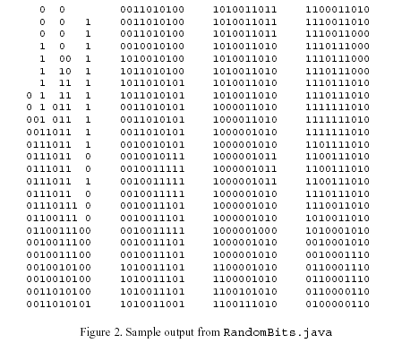
Output from RandomBits

Slide 16
Random Bits
The currentTimeMillis() method of the System class is used in creating the 100ms delay between successive print statements.
To generate a random index between 0 and 9, the nextInt() method is called with “10” as an argument.

Slide 17
Date Class
The Date class encapsulates the current date and time, with millisecond precision.
Date supports the following constructors:
Date() → initializes the object with the current date and time.
Date(long millisec) → accepts one argument that equals the number of milliseconds that have elapsed since midnight, January 1, 1970.

Slide 18
Date Class
Methods:
boolean after(Date date)
Tests if this date is after the specified date
boolean before(Date date)
Tests if this date is before the specified date
int compareTo(Date date)
Compares two dates for ordering
boolean equals(Object date)
Compares two dates for equality

Slide 19
Date Class
long getTime()
Returns the number of milliseconds since January 1, 1970, 00:00:00 GMT represented by this Date object.
void setTime(long time)
Sets this Date object to represent a point in time that is time milliseconds after January 1, 1970 00:00:00 GMT.
string to string()
Converts this Date object to a String of the form.

Slide 20
Example
//Program to show date and time using only Date methods
import java.util.Date;
class DateDemo{
public static void main(String args[])
{ Date date1=new Date();
System.out.println(date);
long msec=date.getTime();
System.out.println(“Milliseconds since Jan 1,1970 GMT=“+msec);
}
}

Slide 21
Calendar Class
The abstract Calendar class provides a set of methods that allows you to convert a time in milliseconds to a number of useful components.
Some examples of the type of information that can be provided are:
Year,month,day,hour, minute and second.
It is intended that subclasses of Calendar will provide the specific functionality to interpret time information according to their own rules.

Slide 22
Calendar Class
Java class library enables us to write programs that can operate in several international environments.
An example of such a subclass is Gregorian Calendar.
Calendar provides no public constructors.
Calendar defines several protected instance variables.

Slide 23
Calendar Class
Calendar defines the following int constants which are used when you get or set components of the calendar:
AM
AM-PM
HOUR-OF-DAY
FIELD-COUNT
DAY-OF-YEAR

Slide 24
Calendar Class
Methods:
abstract void add(int which,int val)
Adds val to the time or date component specified by which.
To subtract, add a negative value which must be one of the fields defined by Calendar,such as Calendar.HOUR

Slide 25
Calendar Class
Boolean after(Object calendar Obj)
Returns true if the invoking Calendar object contains a date that is later than one specified by calendar obj.otherwise it returns false.

Slide 26
Example for Calendar
//Demonstrate Calendar
import java.util.Calendar;
class CalendarDemo{
public static void main(String args[])
{ String months[ ]={“Jan”,”Feb”,”Mar”,”Apr”,
“May”,”June”,”Jul”,”Aug”,
“Sep”,”Oct”,”Nov”,”Dec”};
Calendar calender1=Calendar.getInstance();
System.out.print(“Date:”);
System.out.print(months[calendar1.get(Calendar.MONTH]);
System.out.print(“ ”+calendar1.get(Calendar.DATE)+” “);
System.out.println(calendar1.get(Calendar.YEAR));

Slide 27
Example for Calendar
System.out.Print(“Time:”);
System.out.print(calendar1.get(Calendar.HOUR+”:”);
System.out.print(calendar1.get(Calendar.MINUTE)+”:”)
System.out.print(calendar1.get(Calendar.SECOND));
//set the time and date information and display it
calendar1.set(Calendar.HOUR,10);
calendar1.set(Calendar.MINUTE,29);
calendar1.set(Calendar.SECOND,22);
System.out.print(“Update time:”);
System.out.print(calendar1.get(Calendar.HOUR)+”:”);
System.out.print(calendar1.get(Calendar.MINUTE)+”:”);
System.out.print(calendar1.get(Calendar.SECOND));

Slide 28
OUTPUT
Date : Feb 26 2003
Time: 11:24:25
Update time: 10:29:22

Slide 29
Gregorian Calendar
Gregorian calendar is a concrete implementation of a Calendar.
Methods:
The getInstance() method of calendar returns a GregorianCalendar initialized with the current date and time in the default locale and time zone.
Gregorian calendar defines two fields: AD and BC
These represent the two eras defined by the Gregorian calendar.

Slide 30
Gregorian Calendar
Constructor:
GregorianCalendar()
Initializes the object with the current date and time in the default locale and time zone.
GregorianCalender(int year,int month,int dayOfMonth)
GregorianCalender(int year,int month,int dayOfMonth,int hours,int minutes)
GregorianCalender(int year,int month,intdayOfMonth,int hours,int minutes,int seconds)
boolean isLeapYear(int year)
Is a abstract method, which tests if the year is a leap year.

Slide 31
Example for Gregorian Calendar
//to display the GregorianCalender current time and date
import java.util.Calendar;
import java.util.GregorianCalendar;
class gcalendardemo {
public static void main(String args[]) {
String months[] = {"Jan", "Feb", "Mar", "Apr", "May", "Jun", "Jul", "Aug", "Sep", "Oct", "Nov", "Dec"};
int year;
GregorianCalendar gcalendar = new GregorianCalendar();
System.out.print("Date:");
System.out.print(months[gcalendar.get(Calendar.MONTH)]);
System.out.print(" " + gcalendar.get(Calendar.DATE) + " ");
System.out.println(year = gcalendar.get(Calendar.YEAR));
System.out.print("Time:");

Slide 32
Example for Gregorian Calendar
System.out.print(gcalendar.get(Calendar.HOUR) + ":");
System.out.print(gcalendar.get(Calendar.MINUTE) + ":");
System.out.println(gcalendar.get(Calendar.SECOND));
//test if given year is a leapyear
if (gcalendar.isLeapYear(year)) {
System.out.println("The current year is a leap year");
} else {
System.out.println("The current year is not a leap year");
}
}
}

Slide 33
Output
Date : Jan 25 2001
Time: 11:25:27
The current year is not a leap year.

Slide 34
Characters
Definition : A character is any key you can strike on the keyboard or that can show up on the computer screen.
This includes upper- and lower-case letters, punctuation, marks, and even digits.
To store characters, we declare variables of type char.
Eg. char vitamin, chromosome;
Characters literals can be assigned to char variables using single quotes :
Eg. char vitamin = ‘A’, chromosome = ‘y’, middleInitial = ‘N’;

Slide 35
Characters
Sample_01_CharTest:
class CharTest {
public static void main (String[] args) {
char vitamin = 'A', chromosome = 'y', middleInitial = 'N';
System.out.print(vitamin);
if (chromosome == middleInitial)
System.out.println(chromosome);
else
System.out.println(middleInitial);
}
}
Prints :
AN

Slide 36
Characters
Space character, ‘ ‘
A space is considered a real character.
In the previous example, there’s no space between A & N. To add one, we need to add :
System.out.print(‘ ‘);
Common mistake
assign integer to a character variable.
Eg. char level = 3; (WRONG!!!)
‘0’, ‘1’, ….., ‘9’ and 0,1, ….., 9 are completely different.
Thus the corect way :
Eg. char level = ‘3’; (CORRECT!!!)

Slide 37
Characters
Non-printing character
Eg. \t (tab), \n (newline)
where \ is the escape character.
How do we write a backslash as an escape character???
==> ‘\\’ represents a (single) backslash character.
==> ‘\’’ represents a single quote character

Slide 38
Characters
Here are the character literals that we need to know :
‘A’, …, ‘Z’ Upper-case letters
‘a’, …, ‘z’ Lower-case letters
‘0’, …, ‘9’ Digits
‘.’, ‘,’, ‘!’, ‘”’, etc Punctuation marks
‘\n’ Newline
‘\t’ Tab
‘\\’ Backslash
‘\’’ Single right quote

Slide 39
Characters
The == compares characters for exact equality; thus the case is significant !!! ‘e’ == ‘E’ ==> FALSE

Slide 40
Characters
Important Point to note :
When an integer operation is applied to a character, the character automatically is converted to a number.
Eg. ‘a’ + 1 ‘0’ <= ch ‘A’-’a’
The number to which any character is converted is based on an international convention, called Unicode
==> which assigns a number between 0 and 65,535.

Slide 41
Characters
Important Point to note :
The first 128 codes, from 0 to 127, are used for the English letters and punctuation as well as digits and non-printing characters.
==> these first 128 codes are inherited from ASCII (American Standard Code Information Interchange)

Slide 42
Characters
Sample_03_CharTest1: Converting a character to an integer
class CharTest1 {
public static void main (String[] args) {
int i;
i = (int)'a';
System.out.println("The ASCII code for 'a' is " + i);
}
}
Output :
The ASCII code for ‘a’ is 97.

Slide 43
Characters
Sampel_04_CharTest: Converting an integer to a character
Output :
85 is the ASCII code for U.
class CharTest3 {
public static void main (String[] args) {
char ch = (char)85;
System.out.println("85 is the ASCII code for " + ch);
}
}

Slide 44
Characters
Sample_05_UCtoLC : Converting upper-case letters to lower-case letters
class UCtoLC {
static char upperToLower (char ch) {
// Convert upper case to lower case
if ('A' <= ch && ch <= 'Z')
// ch is an upper-case letter
return (char)(ch + ('a'-'A'));
else
return ch;
}
public static void main (String[] args) {
System.out.println(upperToLower('D') + " " + upperToLower('m'));
}
}
Output :
d m

Slide 45
Characters
Sample_06_CharOps: Other character operations
class CharOps {
static boolean isDigit (char ch) {
return (ch >= '0' && ch <= '9');
}
static int charToInt (char ch) {
return ch - '0';
}
public static void main (String[] args) {
System.out.println("isDigit('3')="+isDigit('3'));
System.out.println("isDigit('X')="+isDigit('X')); System.out.println("charToInt('3')="+charToInt('3'));
}
}

Slide 46
Characters
Some Methods of Character
boolean isDigit (char c) Returns true if c is a digit; returns false
otherwise
boolean isLowerCase (char c) Returns true if c is a lower-case letter; returns false otherwise
boolean isSpace (char c) Returns true if c is a “white space”
character (space, tab, newline and so on) boolean isUpperCase (char c) Returns true if c is an upper-case letter; returns false otherwise
char toUpperCase (char c) Returns the lower-case equivalent of an
upper-case letter c; if c is not an
upper-case, returns c
char toLowerCase (char c) Returns the upper-case equivalent of an
lower-case letter c; if c is not an
lower-case, returns c

Slide 47
The Classes String and StringBuffer
The String Class is immutable (can’t change, add or append).
The StringBuffer Class which is mutable (can change, add or append).
Methods of String & StringBuffer
int length() Returns the present length
char charAt(int index) Returns the character the index
Methods of String
String concat(String s) Concatenates receiver and s
boolean equals (String s) Compares receiver to s
boolean equalsIgnoreCase (String s) Compares receiver to s, ignoring case
int compareTo (String s) Compares receiver to s lexicographically;
return 0 if equal, return -1 if not found.
Others : indexOf, substring, toLowerCase, toUpperCase

Slide 48
The Classes String and StringBuffer
Methods of StringBuffer
void setCharAt(int index, char ch) Replace the character at index with ch
StringBuffer insert(int index, String str) Inserts the string str at index
StringBuffer insert(int index, char ch) Inserts the character ch at index
StringBuffer append(String str) Append the string str at index
StringBuffer append(char ch) Append the string str at index

Slide 49
The Classes String and StringBuffer
The String Class method : public char charAt( int index)
The StringBuffer Class method : public char setCharAt( int index, char ch)
Sample_07_Hello
class Hello {
public static void main(String[] args) {
String s="Hello, Sailor!";
StringBuffer sb = new StringBuffer(s);
sb.setCharAt(7, 'T');
System.out.println(sb);
}
}

Slide 50
The Classes String and StringBuffer
Comparing Strings :
2 ways to convert strings to be compared to lower case and then compare them :
1. Using existing methods from String Class :
s1.toLowerCase().compareTo(s2.toLowerCase())

Slide 51
The Classes String and StringBuffer
Write your own function :Sample_08
static int compare (String a, String b) {
char ai, bi;
for (int i = 0; i<b.length(); i++) {
if ( i == a.length() ) return -1;
else {
ai = upperToLower(a.charAt(i));
bi = upperToLower(b.charAt(i));
if (ai != bi)
if (ai < bi) return -1;
else return 1;
}
}
if (a.length() == b.length()) return 0;
return 1;
}

Slide 52
Quick Review Question
1. Write an application that uses String method compareTo to compare two string input by the user. Output whether the first string is less than, equal to or greater than the second.
Roman numbers are made up of characters M, D, C, L X, V and I, where:-
M = 1000 D = 500 C = 100 L = 50 X = 10 V = 5 I = 1
Write a program that takes a Roman number as a command line argument and displays the Arabic equivalent. The program should be insensitive to case.
Notes:
<number>

Slide 53
Summary of Main Teaching Points
Java API
Random Class
Date class
Calender class
Gregorian Calender classes
String class
StringBuffer Class
Notes:
<number>

Slide 54
Question and Answer Session
Q & A

